Slide 1
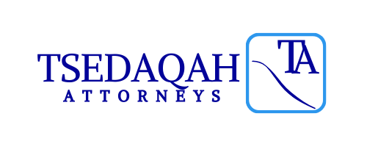
THE ROLE OF THE INTELLECTUAL PROPERTY LAWYER IN THE 21ST CENTURY
BY
CHINASA UWANNA
Ip CONSULTANT, TSEDAQAH ATTORNEYS
C.UWANNA@TA-NG.COM; +234 806 427 1100
www.ta-ng.com

Slide 2
OUTLINE OF PRESENTATION
Objective of Presentation.
Definition of Intellectual Property.
Types of Intellectual Property Rights.
Who is an Intellectual Property Lawyer?
The Role of an Intellectual Property Lawyer.
Recap/ Q&A

Slide 3
OBJECTIVE OF PRESENTATION
Objective
To help you understand the important role of an Intellectual Property Rights Lawyer in the 21st Century.

Slide 4
DEFINITION OF INTELLECTUAL PROPERTY
Intellectual property (IP) refers to creations of the mind: inventions, literary and artistic works, and symbols, names, images, and designs used in commerce…
Inventions in all fields of human endeavor and all other rights resulting from intellectual activity in the industrial, scientific, literary or artistic fields.
- World Intellectual Property Organization (WIPO)

Slide 5
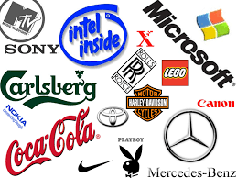
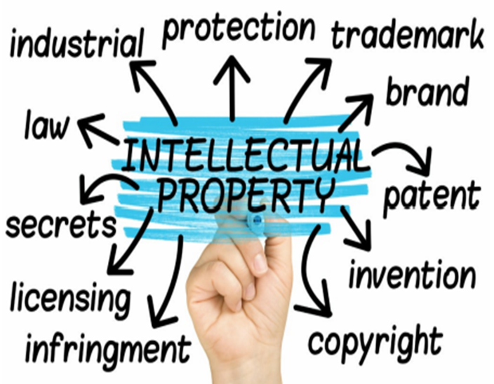
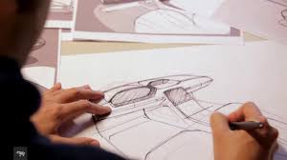
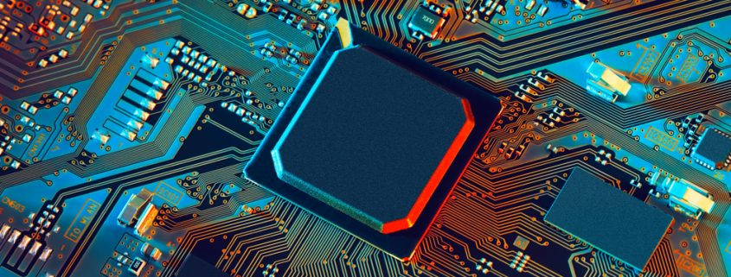
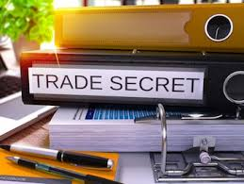
TYPES OF INTELLECTUAL PROPERTY
Domain Names
Geographical Indicators
Copyright
Trademarks
Patents
Artificial Intelligence
Integrated Circuits
Trade Secrets
Industrial Designs

Slide 6
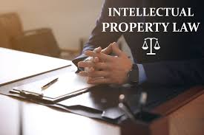
WHO IS AN IP LAWYER?
A lawyer who works in the field of Intellectual Property: Law Firm, In-house, Research Institute, Government etc.
Key Skills:
Technical Knowledge
Analytical reasoning
Good drafting skills
Attention to details/ timelines
Strong Communication skills
Negotiation skills
Organization

Slide 7
THE ROLE OF AN IP LAWYER
Legal Advisory
IP Registration and Maintenance (Brand Management)
Preparation and/or review of IP Agreements
Watch Services and Enforcement
Negotiations and Dispute Resolution/ Infringement actions
Commercial IP Transactions
Technology Transfer (NOTAP Registration etc.)
Product Registration – SON and NAFDAC
Anti-Counterfeiting/ Anti-Piracy

Slide 8
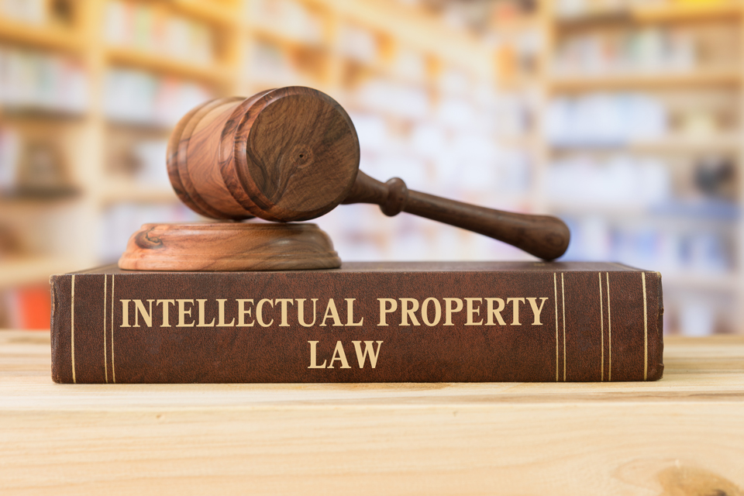
RECAP/ CONCLUSION
“One of the great things about IP Law is how varied it is. When I was a full-time IP Lawyer, I could spend a morning trying to help a winery protect its brand in Europe, and then the afternoon helping an artist respond to a cease and desist letter from a brand owner trying to censor that artist’s work.”
Peter Karol, Professor of Law and Director of the Intellectual Property Law Certificate at New England Law | Boston
The role of the IP lawyer today cannot be overemphasized!

Slide 10
Contact: Chinasa Uwanna
c.uwanna@ta-ng.com
cuwanna@gmail.com
+234 806 427 1100
+1 506 566 3909

